Slide 1
CSE 4205 Digital Logic Design
Assignment on
- Counter with Unused States
- SISO Register
- Address Multiplexing
Submitted by – Md. Farhan Ishmam ID:180041120 CSE - A

Slide 2
Counter with unused States
Unused states are taken in consideration when a sequential circuit uses fewer than maximum number of states
Unspecified states aren’t listed in state table
The unused states can be considered as don’t care or assigned a specific state while simplifying
Circuit must go into a valid state from unused state
If the unused states are treated as don’t care then the effect of unused state has to be determined during designing
The next state from unused state can be determined by analyzing the circuit

Slide 3
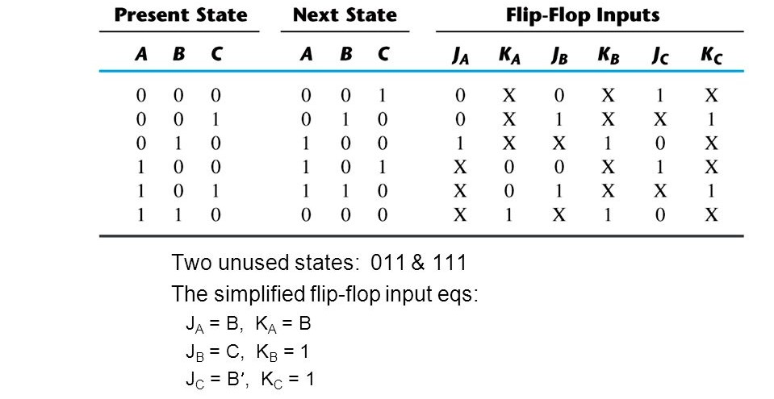
Counter with unused States

Slide 4
Counter with unused States
The count has a repealed sequence of six states, with flip-nap s B and C repeating the binary count 00, 01, 10, and flip-flop A alternating between 0 and 1 every three counts.
The count sequence of the counter is not straight binary, and two states, 011 and 111, are not included in the count. The choice of JK flip-flops results in the flip-flop input conditions listed in the table.
Inputs KB and Kc have only 1’s and X's in their columns, so these inputs are always equal to 1. The other flip-flop equations can be simplified by using min-terms 3 and 7 as don’t care conditions.
The simplified equations are:
JA = B KA = B
JB = C KB = 1
JC = B' KC = 1

Slide 5
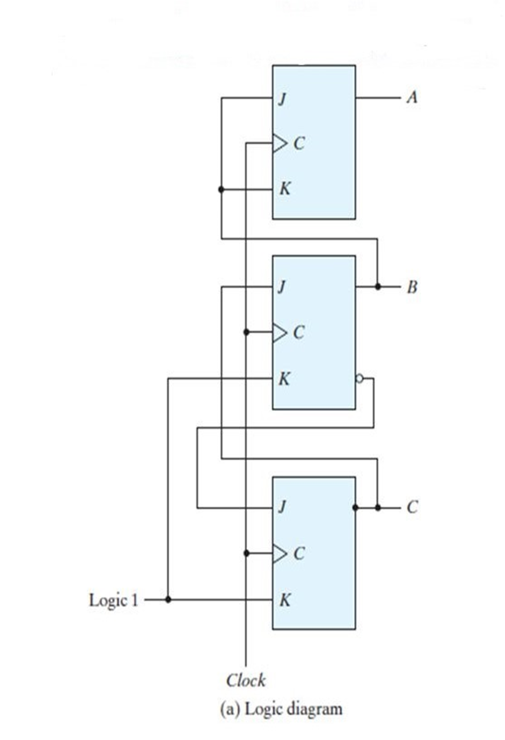
Counter with unused States
Logic Diagram
There are two unused stales in the counter, we analyze the circuit to determine their effect.
If the circuit happens to be in stare 011 because of an error signal, the circuit goes to state 100 after the application of a clock pulse.
This action may be determined from an inspect ion of the logic diagram by noting that when B = 1. the next clock edge complements A and clears C to 0, and when C = 1, the next clock edge complements B.
In a similar manner, we can evaluate the next state from present state 111 to be 000.

Slide 6
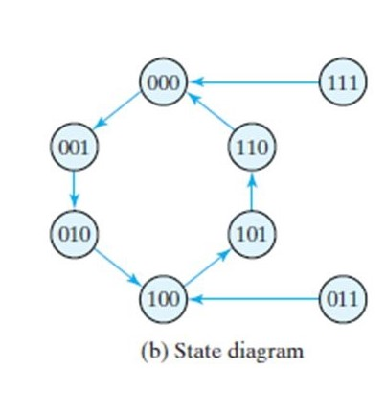
Counter with unused States
State Diagram
In the state diagram, the circuit never goes to one of the unused states
The next count pulse transfers it to one of the valid states and the circuit continues to count correctly.
Thus, the counter is self-correcting. In a self-correcting counter, if the counter happens to be in one of the unused states , it eventually reaches the normal count sequence after one or more clock. pulses.
An alternative design could use additional logic to direct every unused state to a specific next state.

Slide 7
SISO REGISTER
SISO stands for Serial Input Serial Output
A register capable of shifting the binary information held in each cell to its neighboring cell, in a selected direction, is called a shift register. SISO is the simplest kind of shift register
This shift register is unidirectional (left‐to‐right). Each clock pulse shifts the contents of the register one bit position to the right

Slide 8
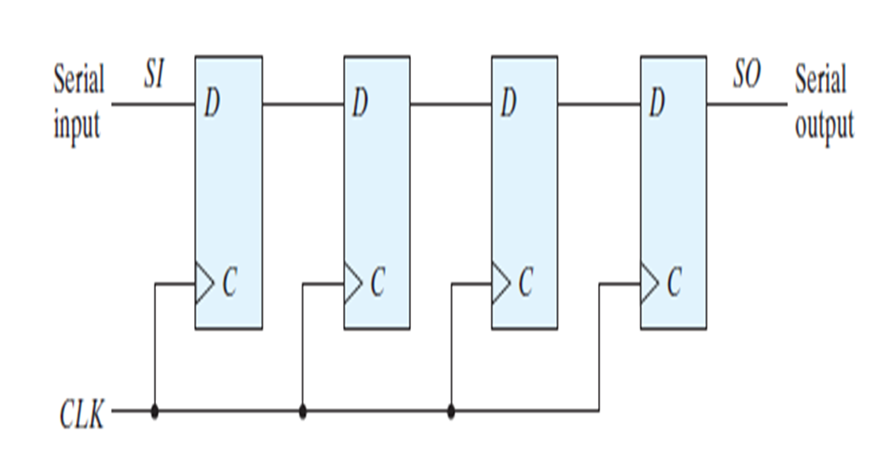
SISO REGISTER

Slide 9
SISO REGISTER
The register is designed by connecting the output of each D flip-flop with the input of the next one
The serial is given at the input of the leftmost flip-flop
The serial output is taken from the output of the rightmost flip‐flop

Slide 10
Address Multiplexing
Definitions:
Address: The identification number of each word (unit of data) of the memory
Multiplexing: The method by which multiple analog or digital signals are combined into one signal over a shared medium
Address Multiplexing: The process through which a multiple tag can call multiple memory location in the address area
Memory arrays:
Efficiently store large amounts of data
Three common types: Dynamic random access memory (DRAM), Static random access memory (SRAM), Read only memory (ROM)

Slide 11
Address Multiplexing
Use of Address Multiplexing:
Address Multiplexing is generally used in DRAM chips to reduce the number of pins on the chip and thus reduce the size of the chip. DRAM stands for Dynamic Random Access Memory which is a type of random access semiconductor memory.
Most DRAM chips multiplex the row and column addresses onto the same set of pins
Two strobes, RAS* (row address strobe) and CAS* (column address strobe) are used to tell the chip which part of the address is currently on the address pins.

Slide 12
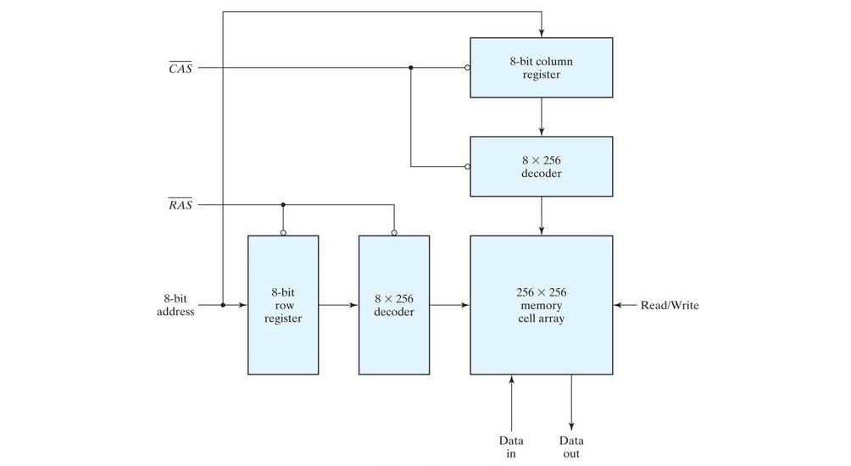
Address Multiplexing for 64K DRAM:

Slide 13
Address Multiplexing
Description of Diagram:
8-bit address is given as input to the 8-bit column and row registers
The RAS and CAS are passed to both the register and decoders
The output of each register is passed to their individual 8*256 decoders
The two 8*256 decoders give 256 bit address row input and 256 bit address column input to the 256*256 memory cell array
In this way, the 256 bit address input is reduced to 8 bit only by using the two decoders

